Slide 1
“This Excel dashboard transforms raw HR data into meaningful insights through dynamic charts, KPIs, and trend lines. Using Excel formulas, conditional formatting, and visuals, it tracks employee turnover, training effectiveness, and satisfaction — enabling users to monitor workforce performance and identify areas for improvement in an interactive, decision-ready format”

Slide 2
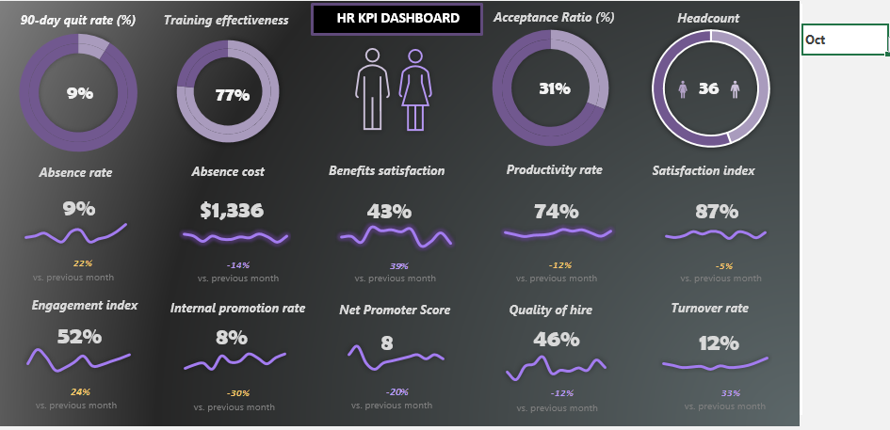
HR Vitals: Employee Performance Overview

Slide 3
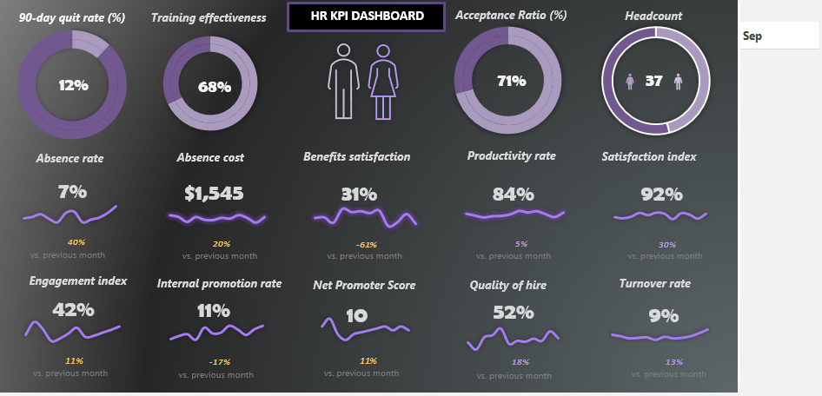
HR Vitals: Employee Performance Overview

Slide 4
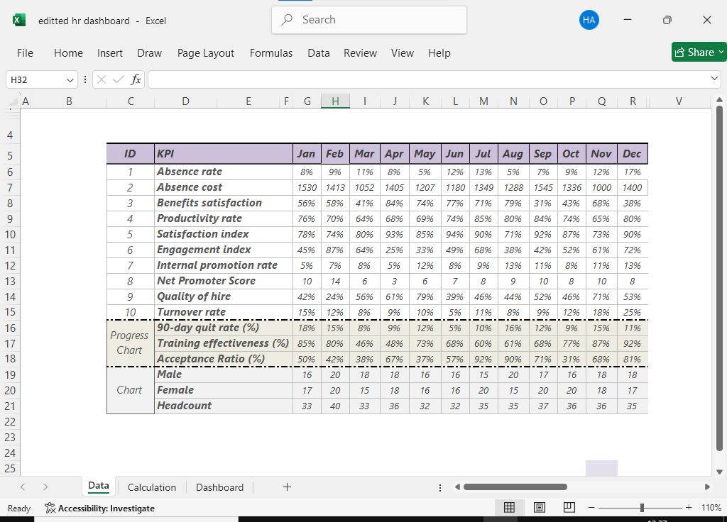
HR Vitals: Employee Performance Overview
BambooHR - Stores clean and raw data

Slide 5
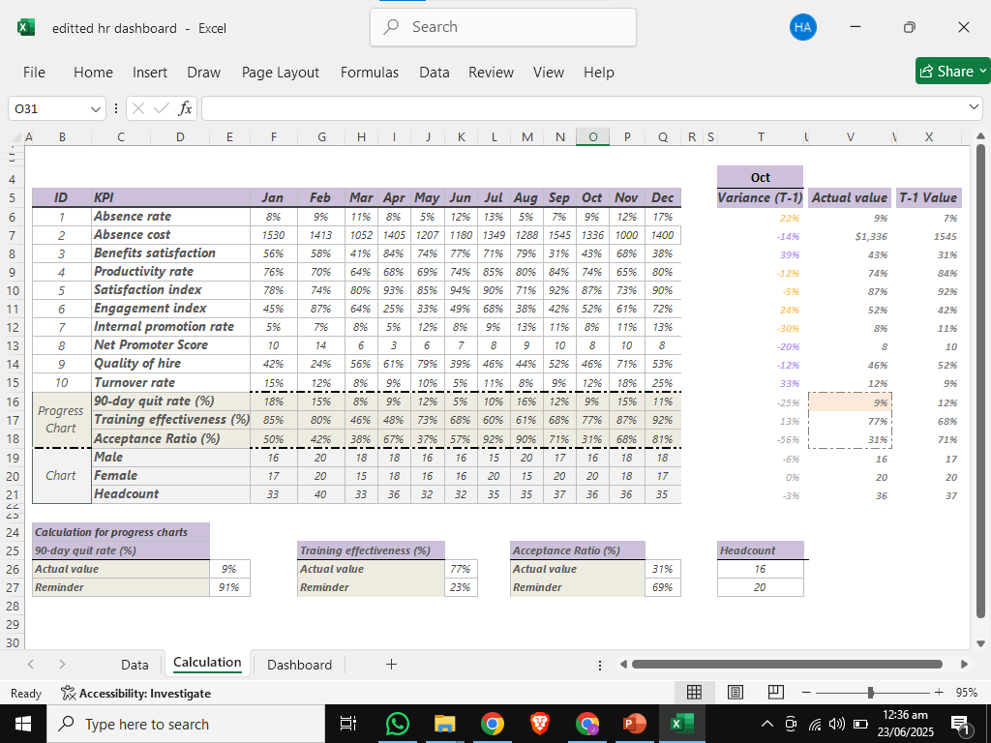
HR Vitals: Employee Performance Overview
Calculation Notebook

